Slide 1

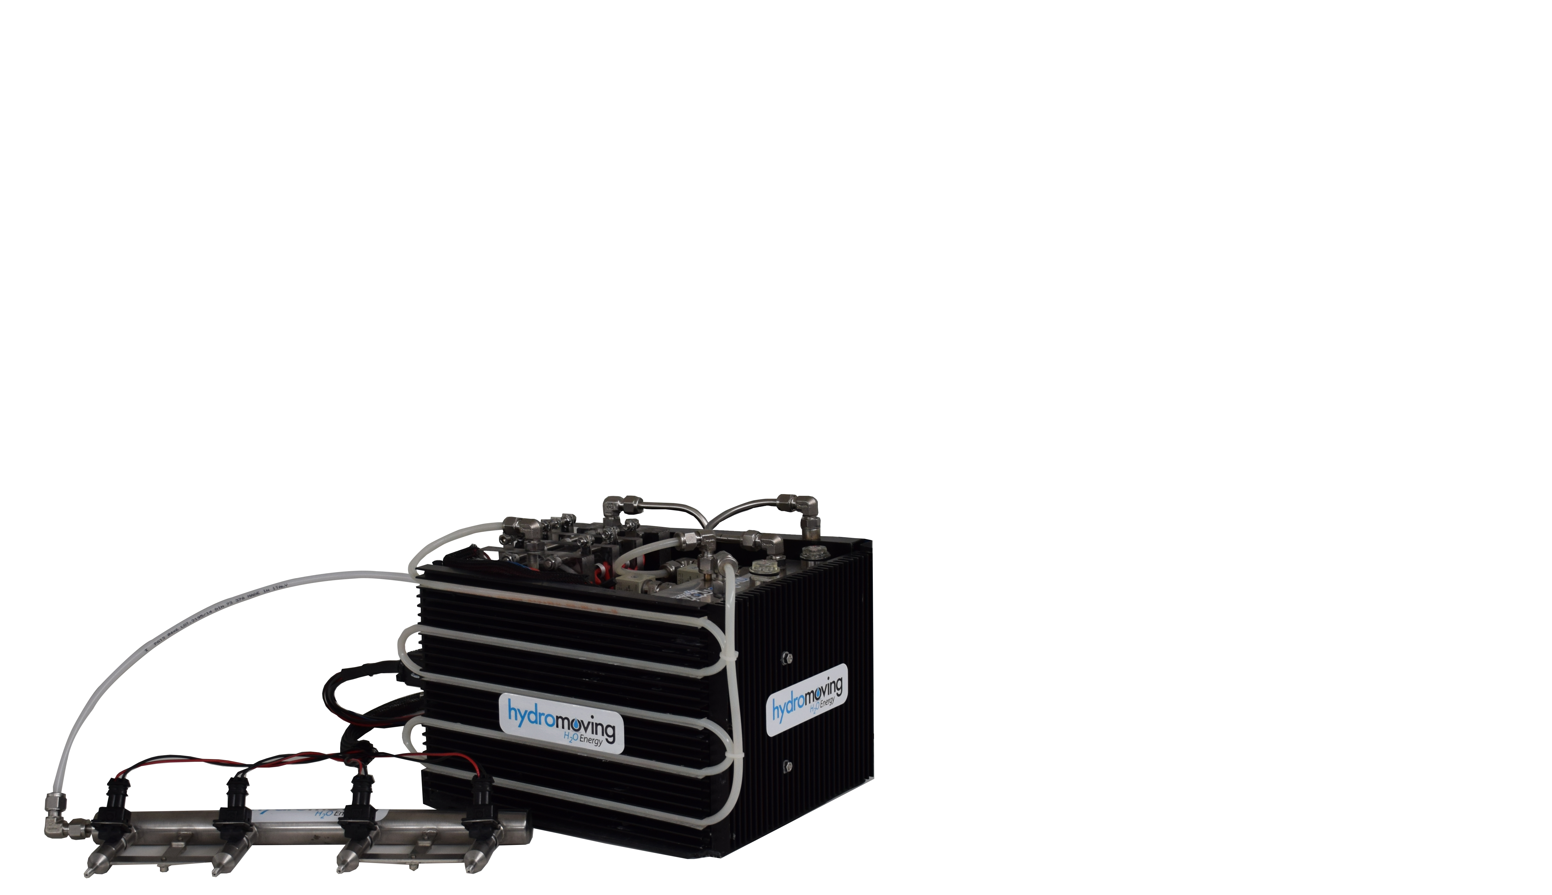
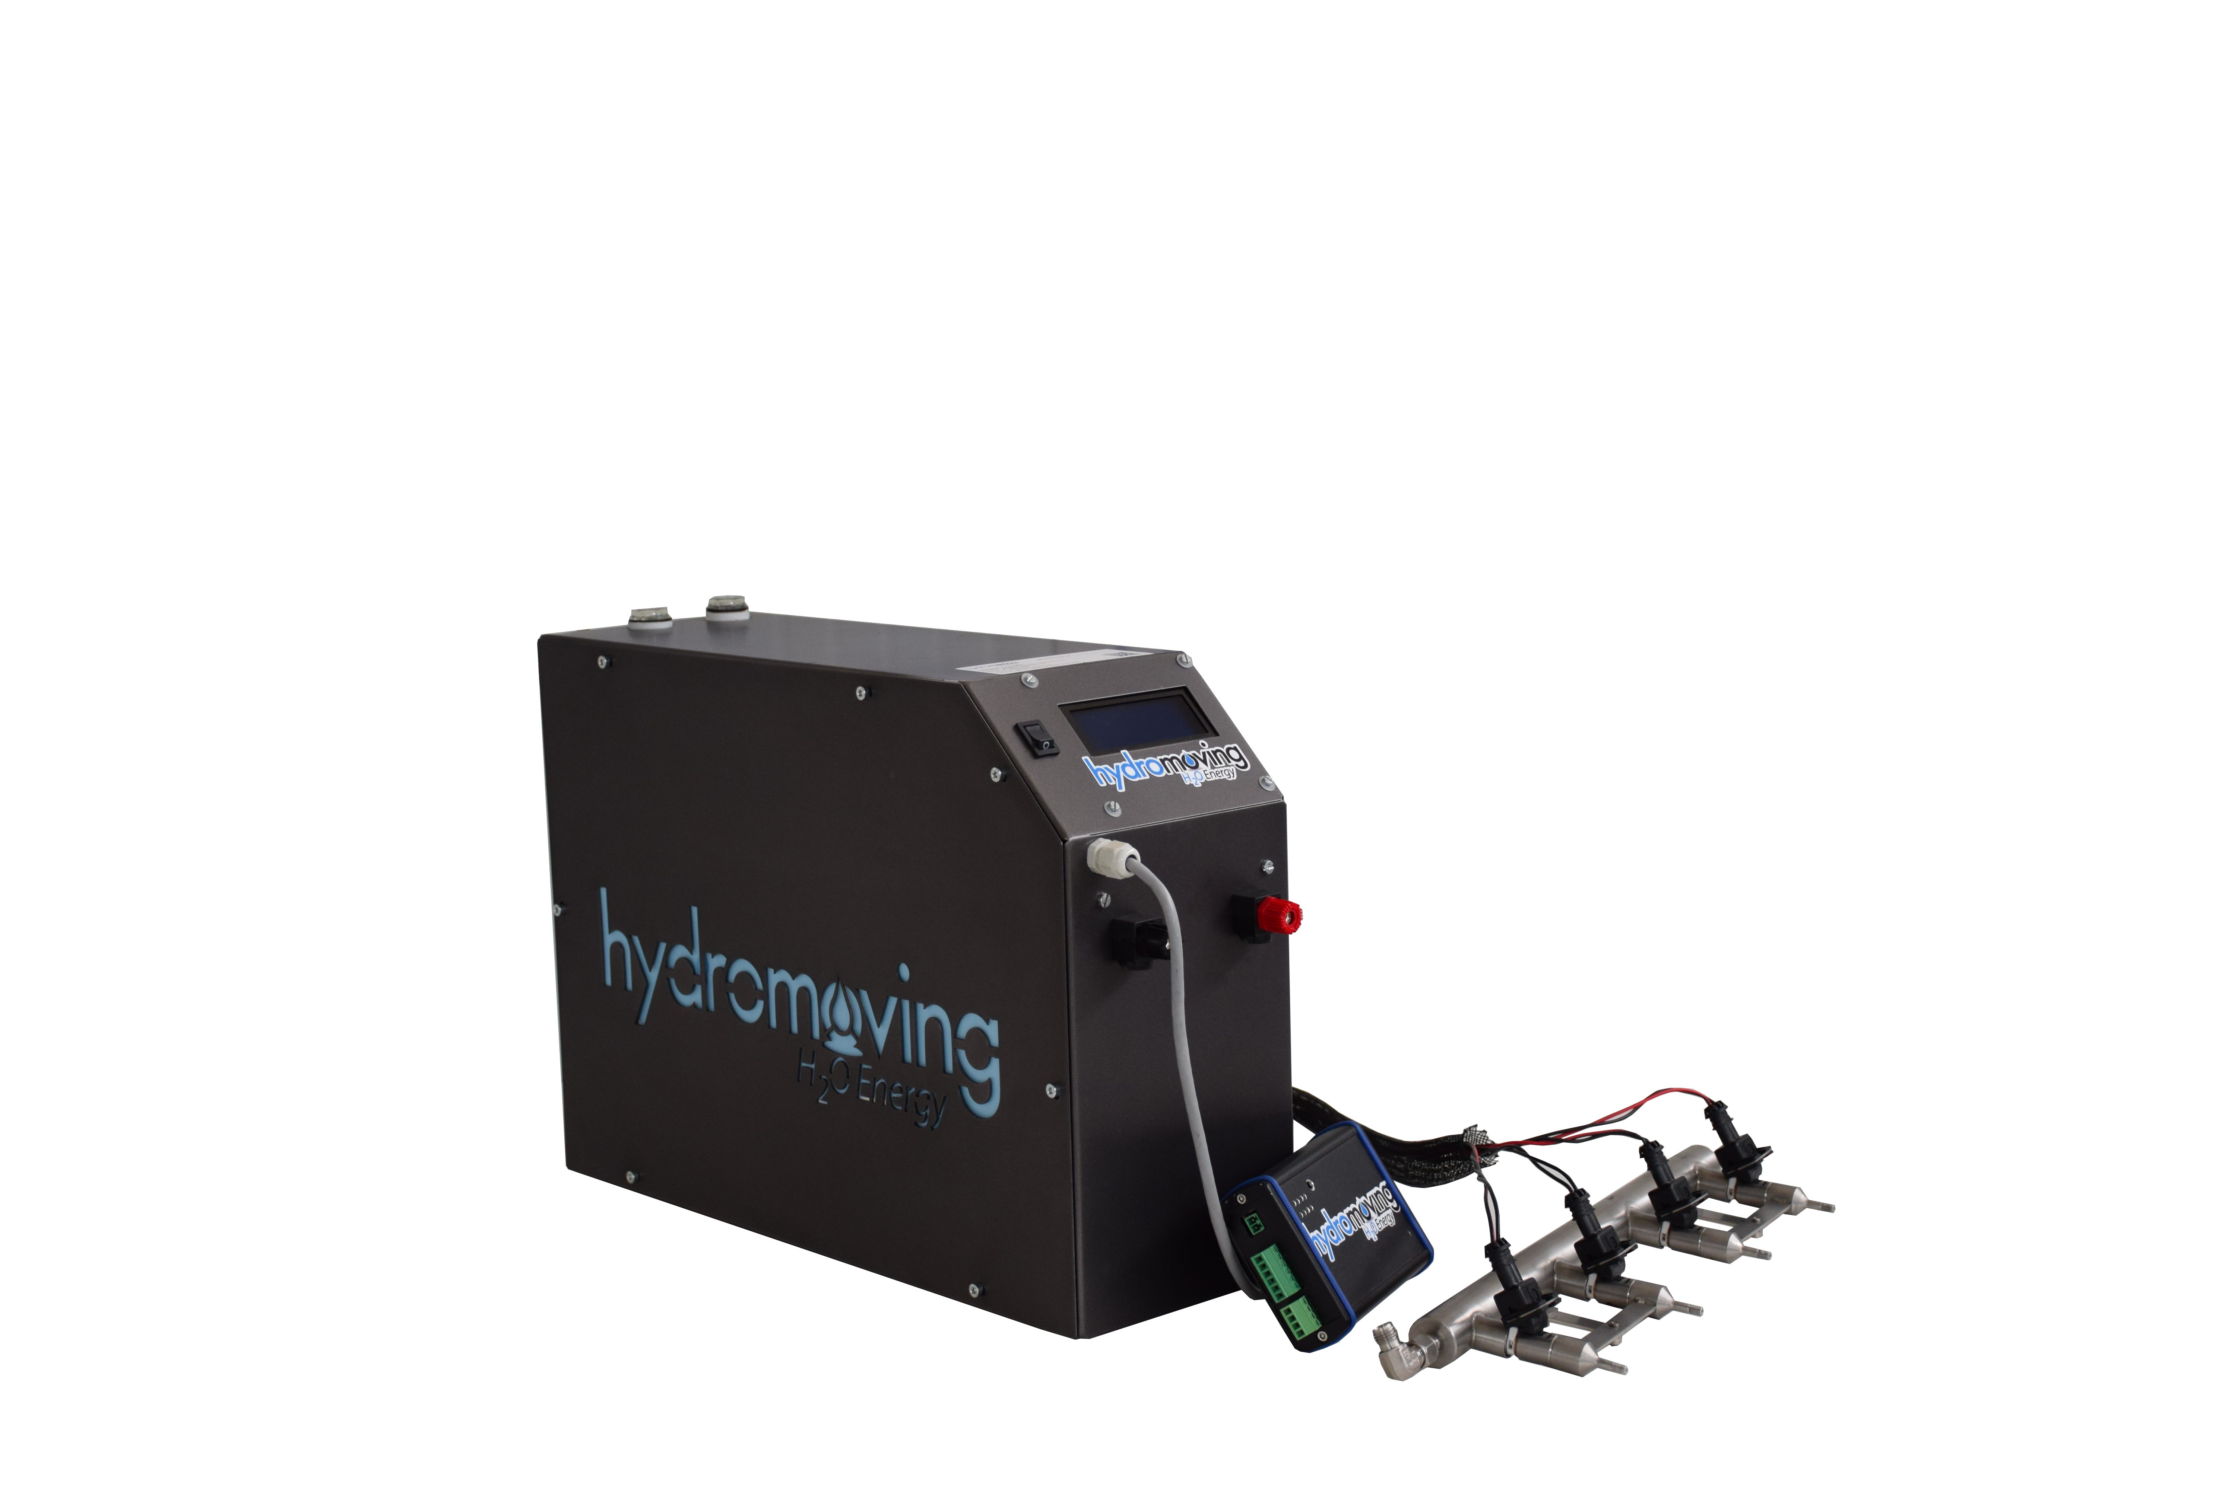
Water system For Engine’s Improvement
Hydrogen-Oxygen mixture generator
Patent: 0001404965
Patent: 0001405327
Hydromoving
Water’s Energy
Compact System – hm01
Fap/Dpf Cleaner ver. 2016
Compact System Pro- hm3250 ver. 2018
Fap-Dpf Cleaner, Engine Displacement 3200-5000

Slide 2
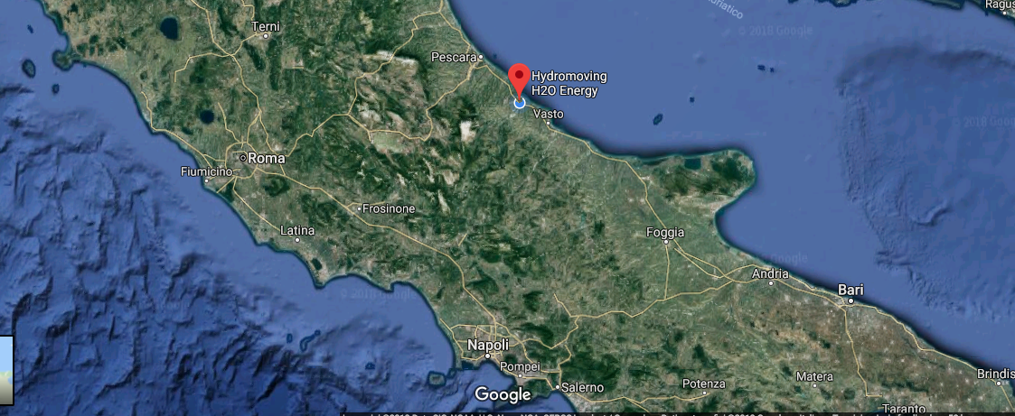


The company "Hydromoving srl" is located in Fossacesia (CH), Italy
For info and more +39 339 783 5888
+39 331 2404681
info@hydromoving.com

Slide 3
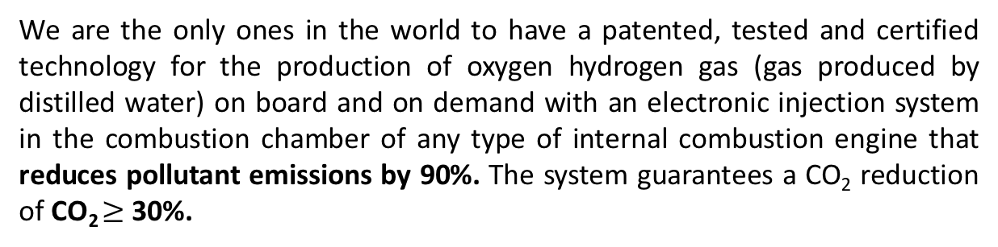
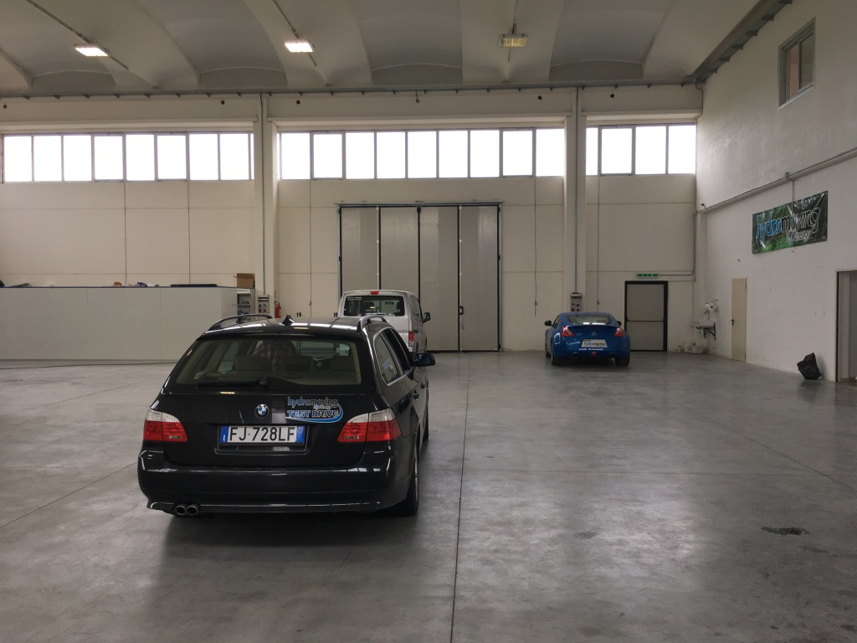
The company Hydromoving Srl was founded thanks to the commitment of Lorenzo Errico and his passion for engines, electronics and innovations bound to "green technologies“. In this path several enthusiasts join in his own sector, creating the HydroMoving project.

Slide 4
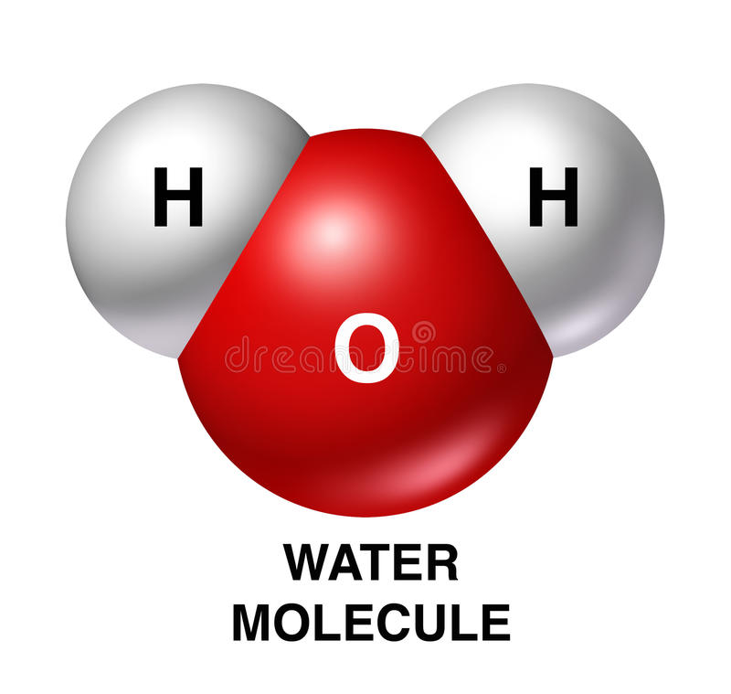
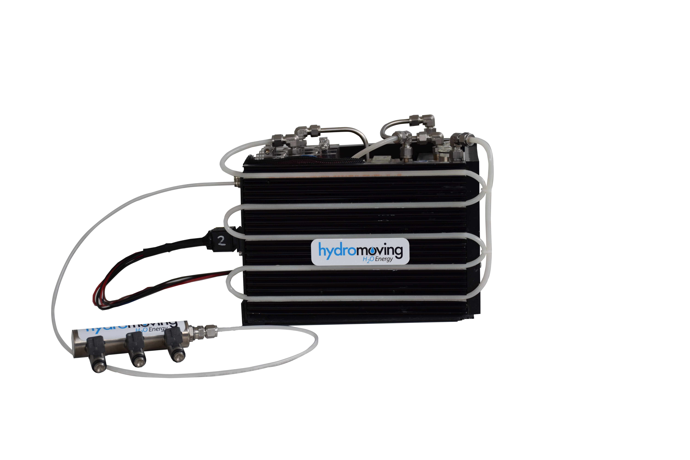
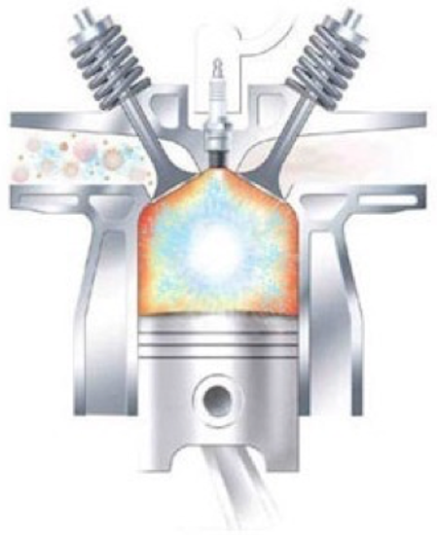
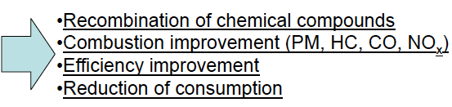
The Hydromoving System
an innovative device for producing and adding a mixture of H₂, O₂ and a minimum calculated amount of water droplets to the conventional fuel flow of an internal combustion engine.
The injected gas into the ICE:
It is produced by an innovative approach on the principle of classical electrolysis
It determines an improvement in engine power
It improves and optimizes the fuel consumption
Reduces the polluttant concentration relaesed at the exhaust
H₂
O₂
Patent: 0001404965
Patent: 0001405327

Slide 5
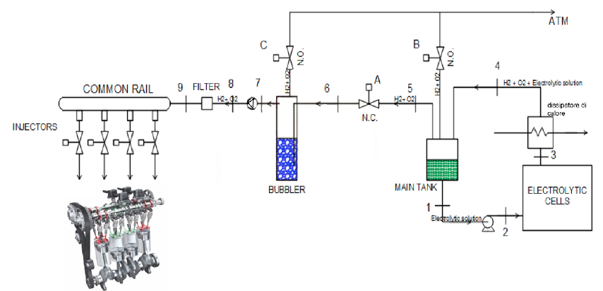
System Operation Circuit Schematic
Patent: 0001404965
Patent: 0001405327

Slide 6
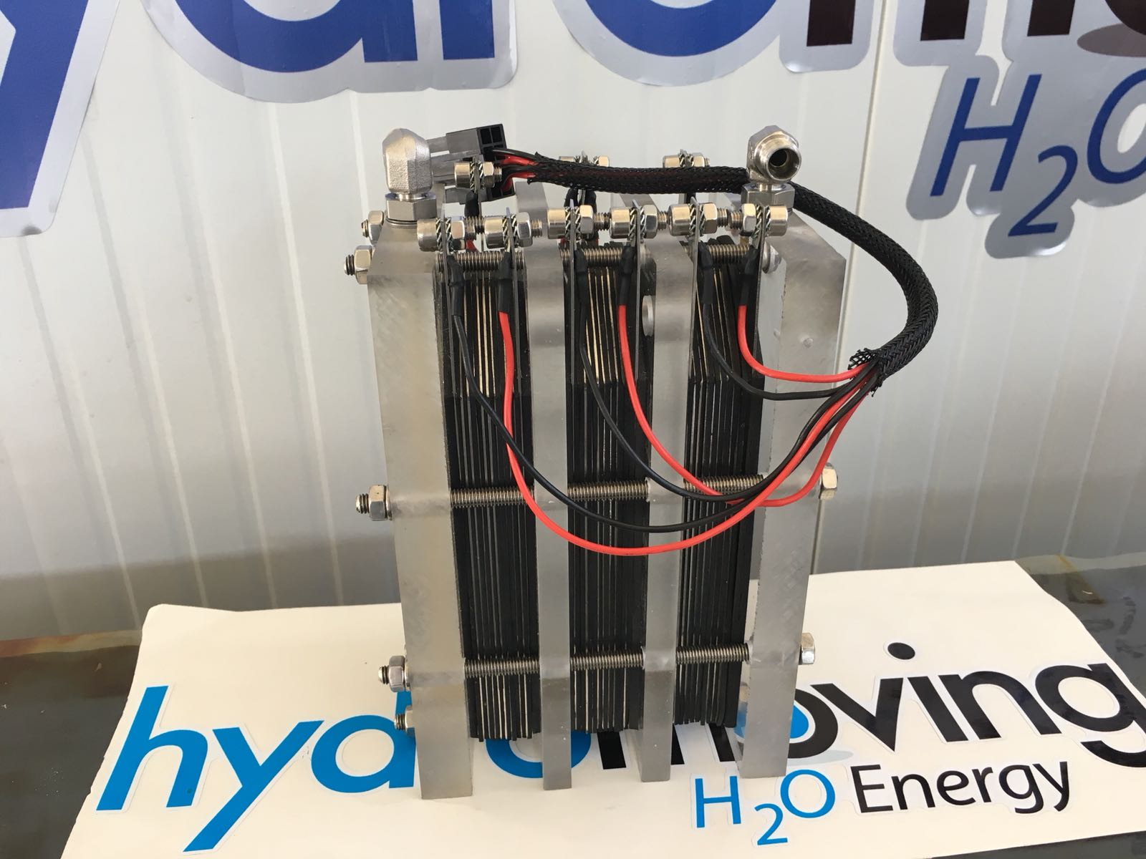
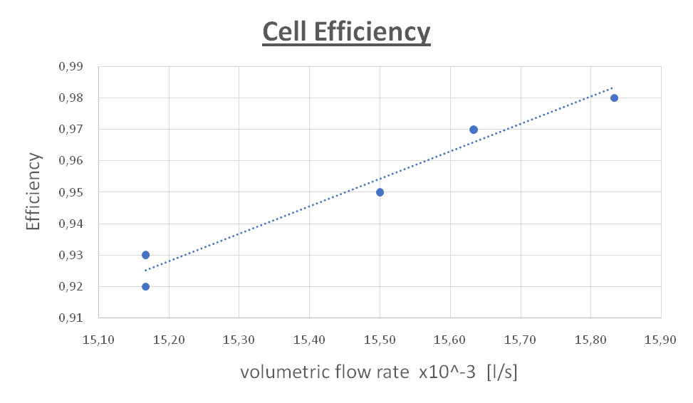
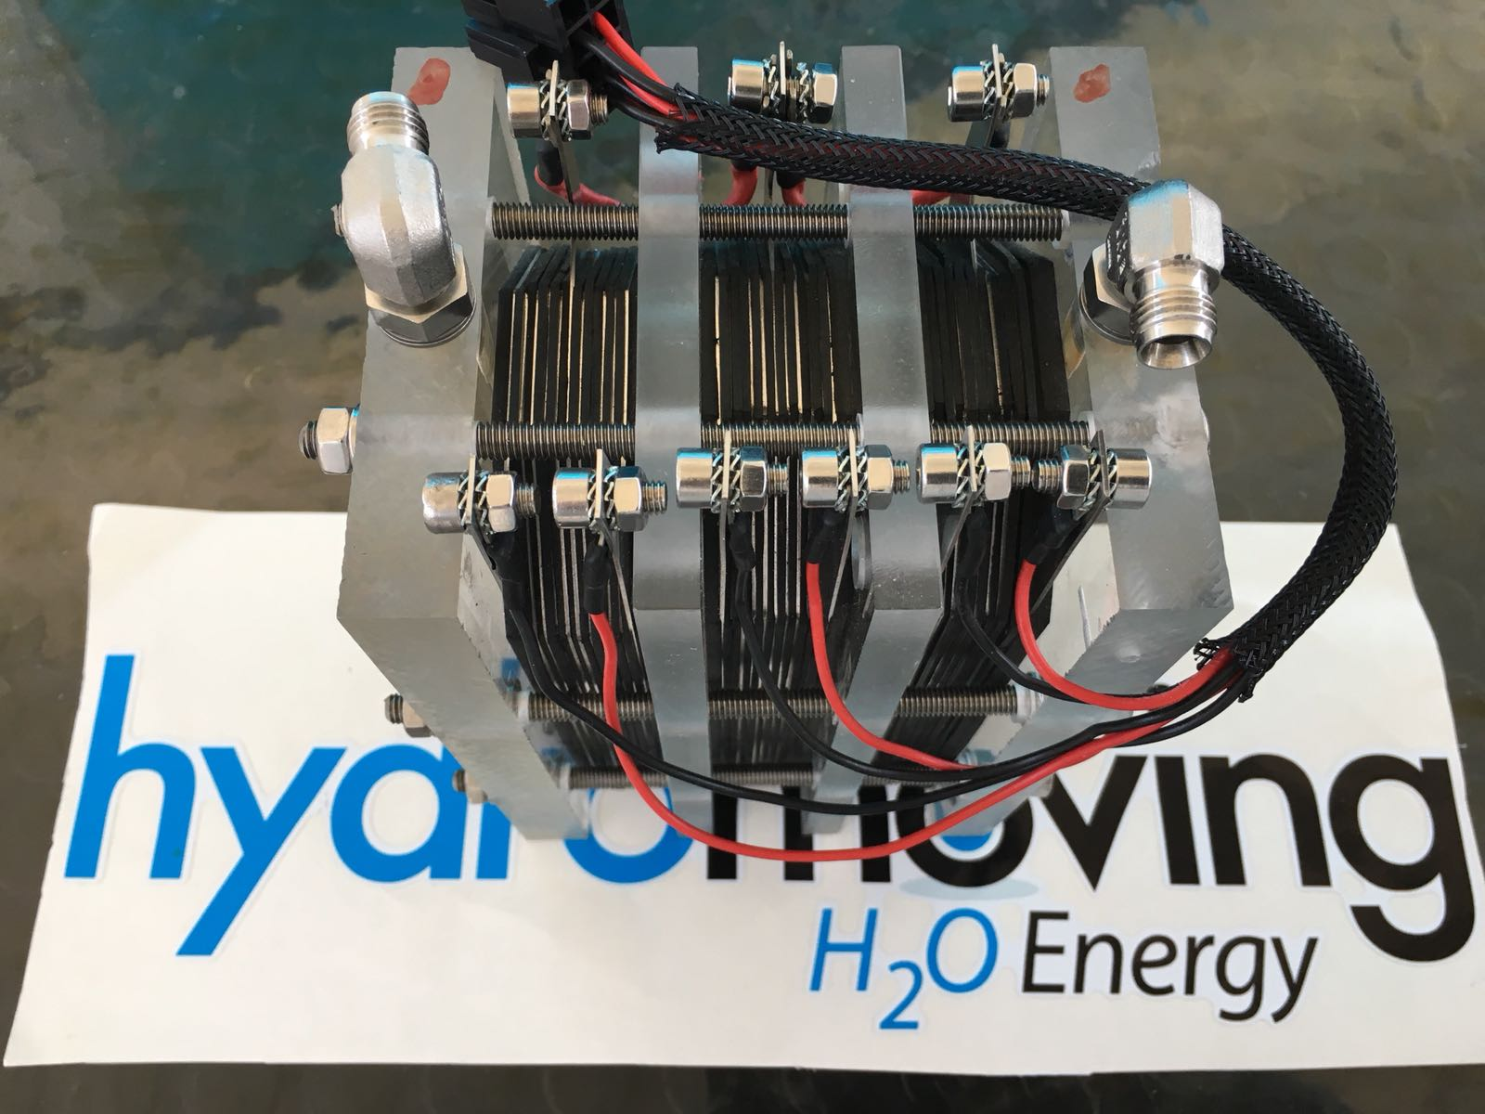
Hydromoving Electrolytic Cells Efficiency diagram until 98%
Patent: 0001404965
Patent: 0001405327
Several test-run in our laboratory show the efficiency of gas production rate in a range between 92% and 98%. The efficiency is intended as a comparison with theoretical process (for which the efficiency is 100%)
The HM System is the only one in the world that uses 1 mm² cables for the supply of electrolytic cells.
Suche results came from the application of the approach suggested by the theory of ”Coherence Domains" of water, released by the Italian physicists Prof. Emilio Del Giudice and Prof. Giuliano Preparata.

Slide 7
Historical Notes

Slide 8
Water in ICE – historical notes
Engine with water injection (WWII)
Aviation Engines:
- BMW 801 (14 cylinders – radial – double star – 1600Hp – 41 liters)
- Daimler-Benz DB 605 with MW 50 (12 cylinder – V revers 60° – 2100Hp – 36 liters)
- Pratt & Whitney R-2800 (18 cylinders radial – double star – 1474Hp – 46 liters)
This system allowed to increase the available engine power through the injection into the cylinder of fuel with a mixture composed by 50% water and methanole, for a short time period (10’). Without water the DB 605DC engine generated a maximum power around 1’474 Hp (1’099 kW), with water system switched on, called MW 50 , this power went up to 2’000 Hp (1’491 kW)

Slide 9
Water in ICE – historical notes
Engine released with water injecton system
Automotive:
- Escort Cosworth 4wd – (fino a oggi, racing)
- Oldsmobile F-85 (1962)
- Saab 99 Turbo S (1978)
These systems were used with two purposes:
- Reduce the inlet air temperature (for turbo and naturally aspirated)
- Let the increase of engine compression ratio (Otto cycle)

Slide 10
Water in ICE
RESEARCH AND STUDIES REFERENCES
Active role fo Water and
Hydrogen

Slide 11
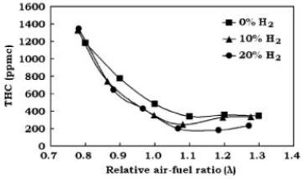
Hydrogen in ICE
Effect of Hydrogen Enriched Hydrocarbon
Combustion on Emissions and Performance
Jacob Wall
Department of Biological and Agricultural Engineering
University of Idaho 1970
•Exhaust recombination
•Combustion improvement (PM, HC, CO)
•Active role on nytrogen oxides
•BSFC improvement

Slide 12
Hydrogen in ICE
Investigation of turbulent combustion in SI-homogeneous
charge engines using hydrogen-gasoline mixtures
Enrico Conte
LAV - Institut fuer Energietechnik
ETH Zurich
2006
•Exhaust recombination
•Combustion improvement (PM, HC, CO)
•Active role on nytrogen oxides
•BSFC improvement
Here are investigated NOT
engine hydrogen fed, but
around
Hydrogen added to
combustion.

Slide 13
Hydrogen in ICE
Effect of H2/O2 addition in increasing the thermal
efficiency of a diesel engine
S. Bari , M. Mohammad Esmaeil
Sustainable Energy Centre, School of Advanced Manufacturing and
Mechanical Engineering, University of South Australia, Australia
2010

Slide 14
Hydrogen in ICE
Effect of H2/O2 addition in increasing the thermal
efficiency of a diesel engine
S. Bari , M. Mohammad Esmaeil
Sustainable Energy Centre, School of Advanced Manufacturing and
Mechanical Engineering, University of South Australia, Australia
2010

Slide 15
Hydrogen in ICE
Effect of HHO gas on combustion
emissions in gasoline engines
Sa’ed A. Musmar , Ammar A. Al-Rousan
Department of Mechanical Engineering,
Faculty of Engineering,
Mutah University, Mutah, Jordan
2011

Slide 16
Hydrogen in ICE
Effects of On-board H2 and Water Injection
in a Diesel Generator
Rick Cameron
University of Southern Queensland
Faculty of Engineering and Surveying
2012
•Exhaust recombination
•Combustion improvement (PM, HC, CO)
•Active role on nytrogen oxides
•BSFC improvement

Slide 17
Hydrogen in ICE
PERFORMANCE CHARACTERISTICS OF OXYHYDROGEN
GAS ON TWO STROKE PETROL ENGINE
G.Ajay Kumar, G.VenkateSwara Rao
Dept.of ME, Bonam Venkata Chalamamaiah
College of Engineering &Technology, Odalarevu, AP, India
2013
•Exhaust recombination
•Combustion improvement (PM, HC, CO)
•Active role on nytrogen oxides
•BSFC improvement

Slide 18
Conventional System for Hydrogen Generation

Slide 19
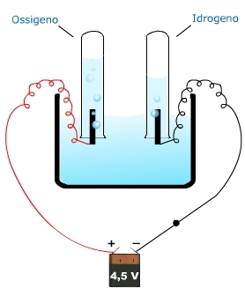
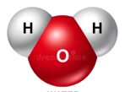



Supplying electric energy it’s possible the scission of
water mulecules obtaining hydrogen and oxygen, as
demonstrated by electrochemical Faraday laws.
Typical Basic
Electrolitic Cell
But….
Such process requires
Total energy given: 286,1 kJ/mol (0.07947 kWh)
benefit
cost
[242 kJ/mol is equivalent to 2.5 eV referred at single molecule]
Total energy available (ideally): 242 kJ/mol (0.06722 kWh)
In ideal combustion conditions of produced hydrogen, it’s
possible use just the 85% of used energy for its production
H₂
H₂
O₂

Slide 20
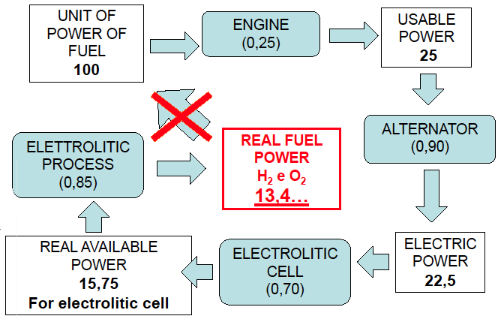
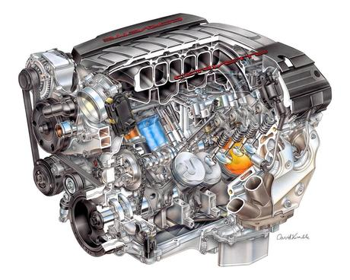
Supplying a cell using the engine’s power:

Slide 21
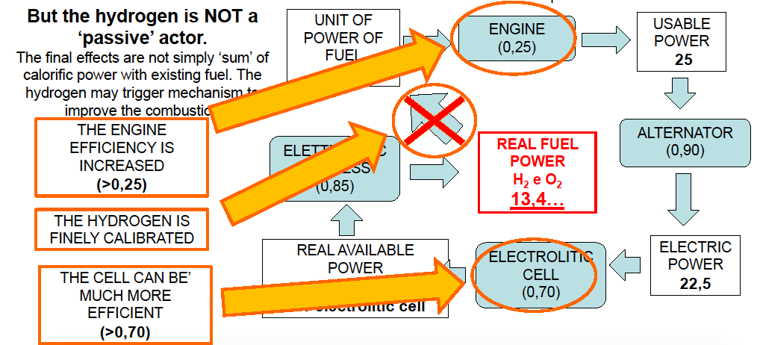
Supplying a cell using the engine’s power:

Slide 22
Theoretical Notes
Patent :
0001404965
0001405327
Hydromoving Technology
How it works and why
Requires very low power

Slide 23
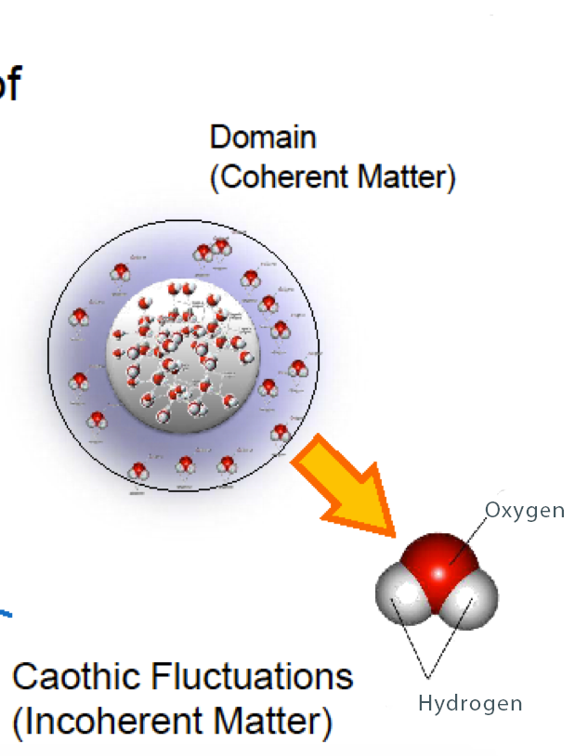

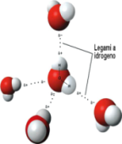
Efficient system for hydrogen supplying to the ICE
Patent- 0001404965/0001405327
The water is seen like a group of
COHERENCE DOMAINS
Caothic Fluctuations
(incoherent matter)
2-fluids model

Slide 24
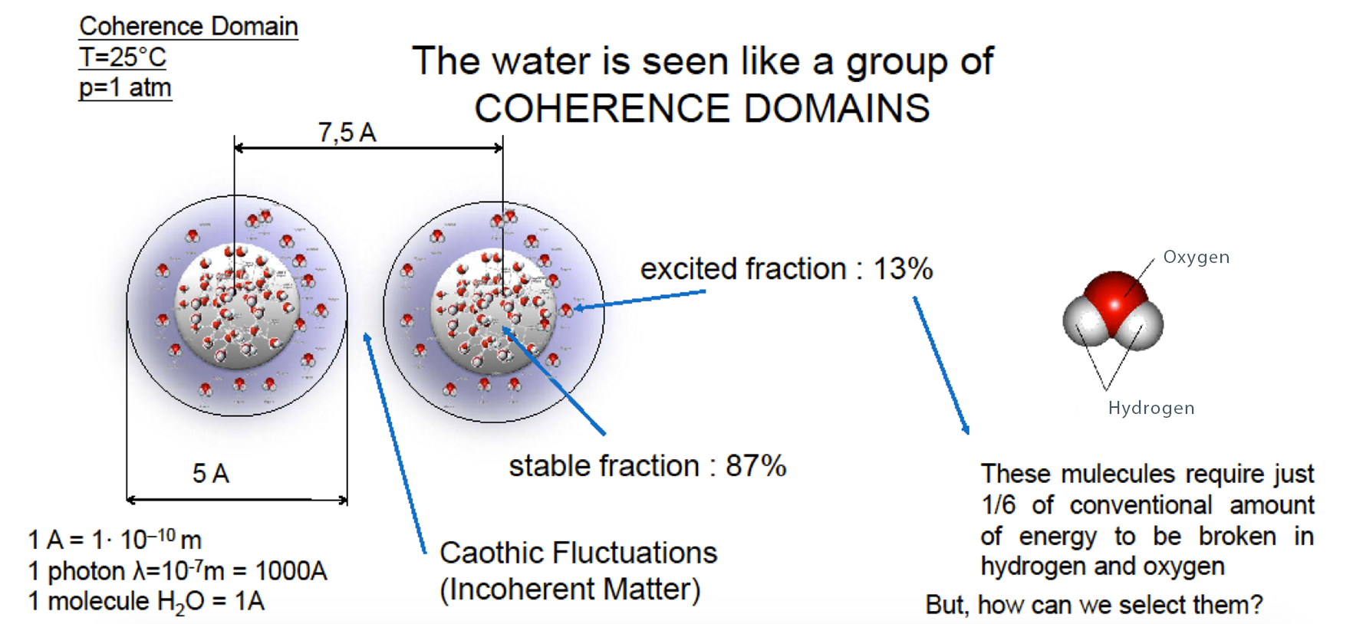
Efficient system for hydrogen supplying to the ICE
These mulecules require just 1/5 (0.5eV) of conventional amount of energy (2.5eV) to be separated in hydrogen and oxygen

Slide 25
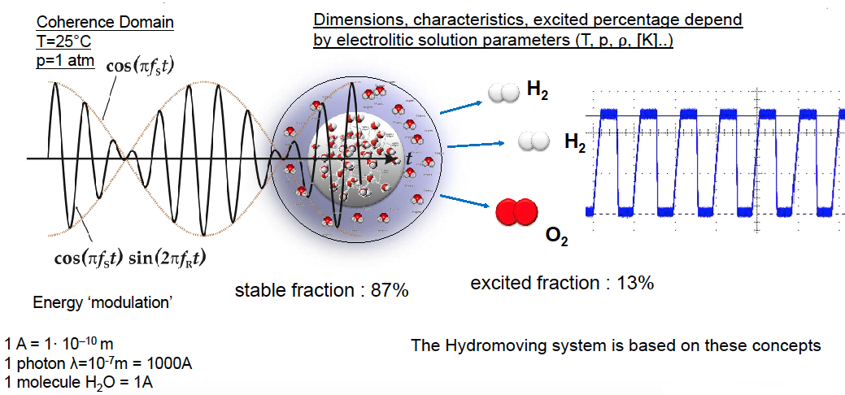
Efficient system for hydrogen supplying to the ICE

Slide 26
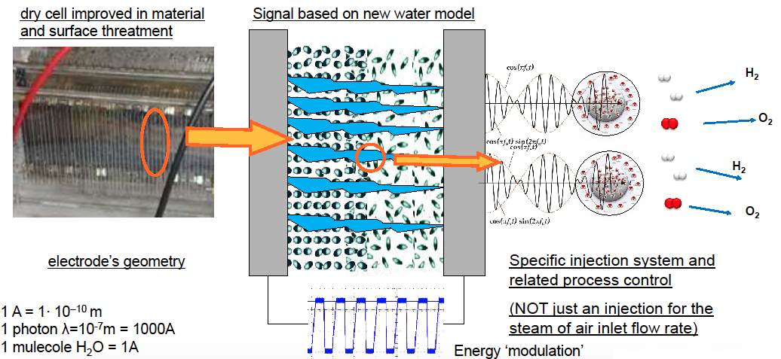
Efficient system for hydrogen supplying to the ICE

Slide 27
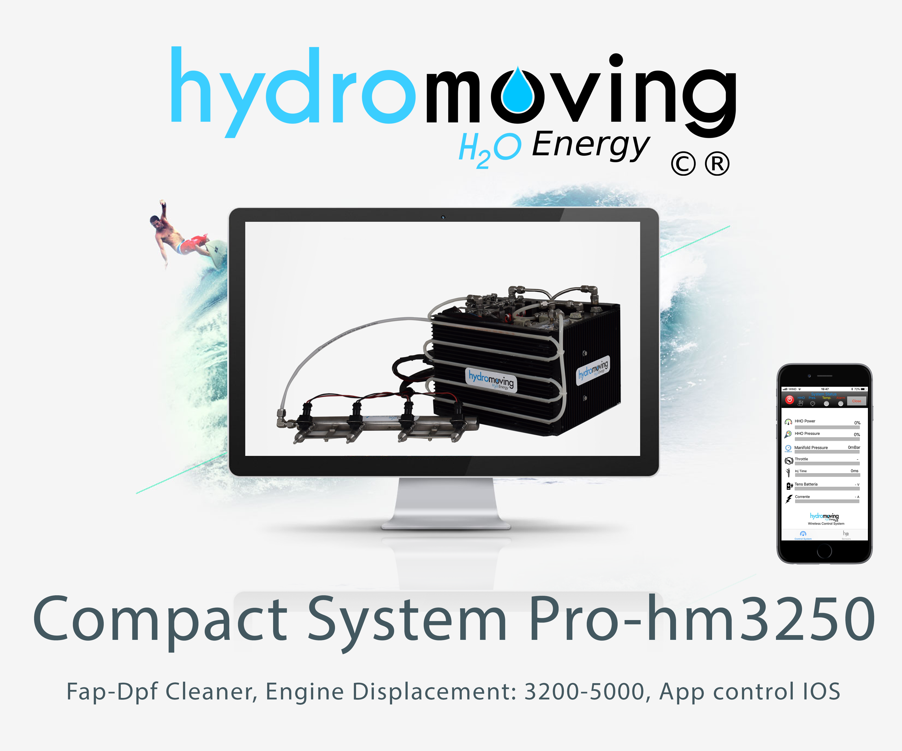
Result
Patent: 0001404965
Patent: 0001405327

Slide 28
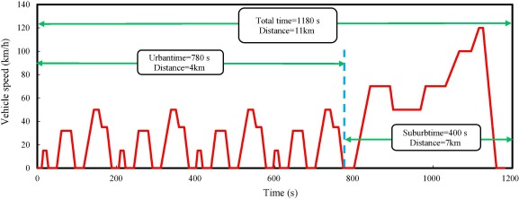
European NEDC Cycle : the challenge
Patent: 0001404965
Patent: 0001405327

Slide 29
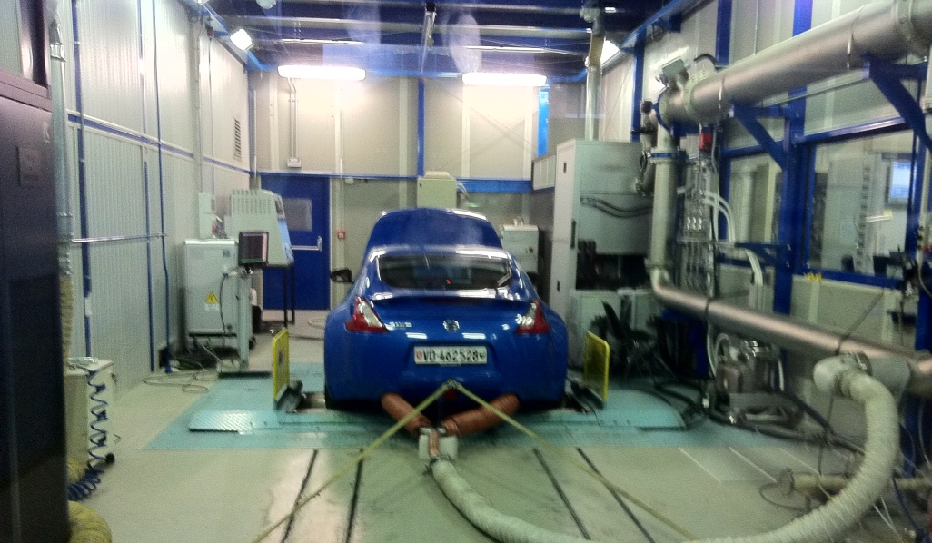
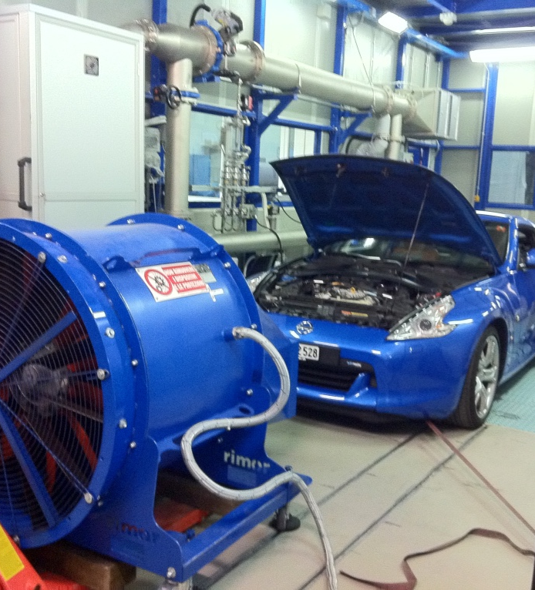
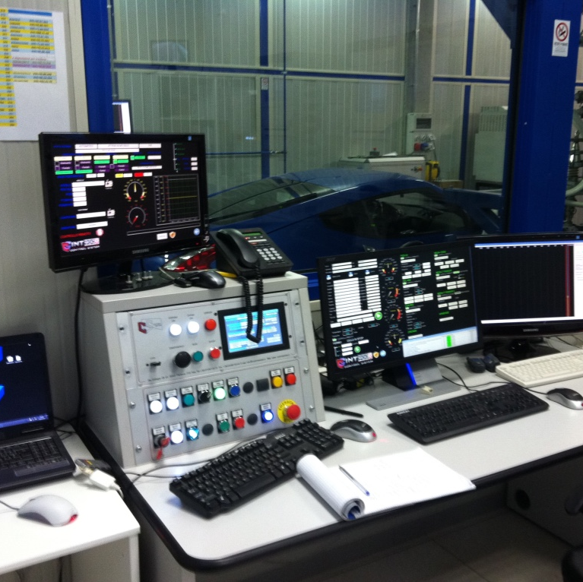
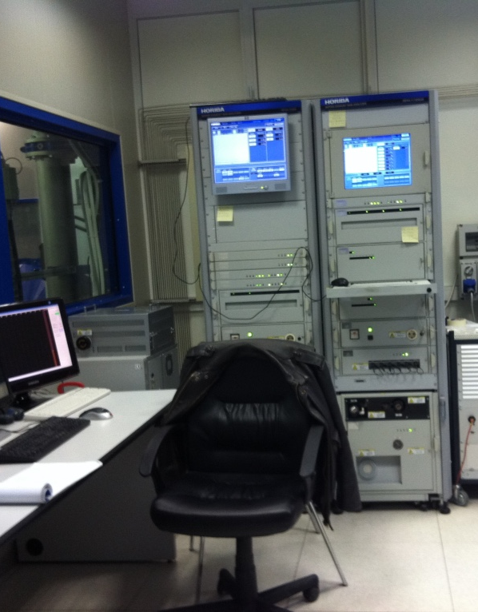
Tests performed at International Laboratories accredited with the Italian Ministry of Transport.
Control Sistem, MMarelli, FCA / Elasis.

Slide 30
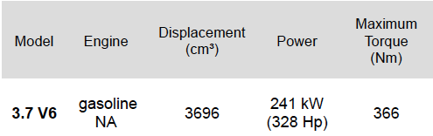
TESTED VEHICLE
Nissan 370 Z
Patent: 0001404965
Patent: 0001405327

Slide 31
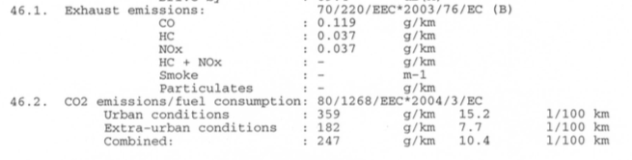
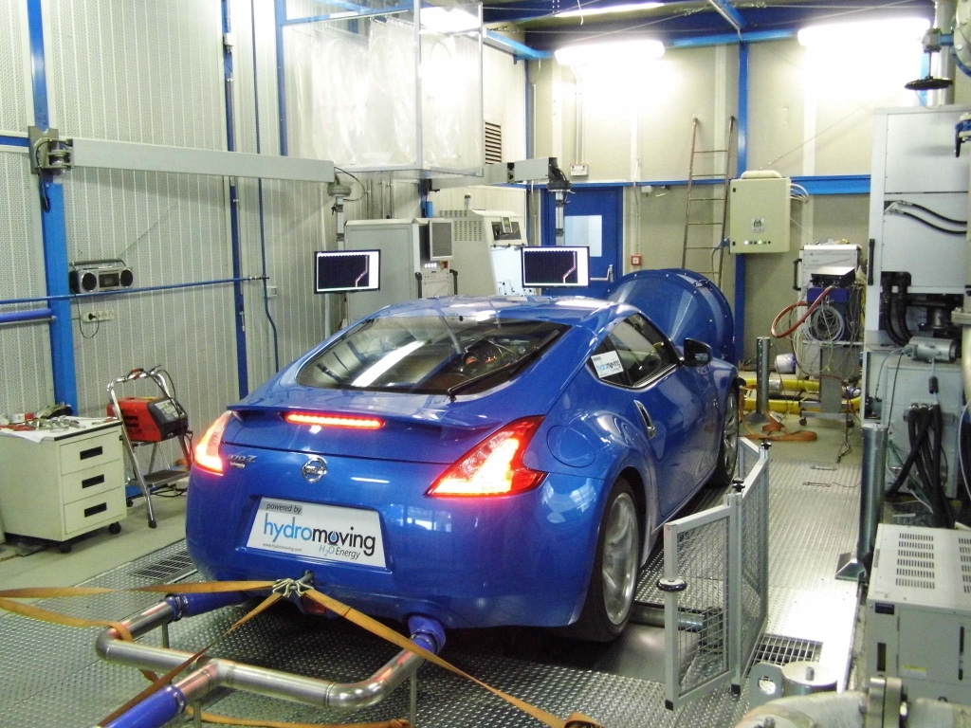
Test results of 4 NEUDC cycles
performed at Control System
(Turin) May 2011.
Nissan 370 Z engine displacement 3700 cc. petrol.
Hydromoving system integrated into the vehicle.
Emissions values declared by the manufacturer

Slide 32
TEST PERFORMED IN MAY 2012 ON NISSAN 370Z 3700 cc ENGINE DISPLACEMENT

Slide 33
EMISSIONS IMPROVEMENT
Nissan 370 Z
comparison HC
comparison CO
- 84%
- 89%
HC emissions comparison between reference
condition and new conditions given by
Hydromoving system [REF.test 2011/2, CS]
CO emissions comparison between reference
condition and new conditions given by
Hydromoving system [REF.test 2011/2, CS]

Slide 34
EMISSIONS IMPROVEMENT
Nissan 370 Z
comparison CO₂
comparison NO_{x}
- 17%
- 10%
CO2 emissions comparison between reference
condition and new conditions given by
Hydromoving system [REF.test 2011/2, CS]
NO_{x} emissions comparison between reference
condition and new conditions given by
Hydromoving system [REF.test 2011/2, CS]

Slide 35
EMISSIONS IMPROVEMENT
Nissan 370 Z
comparison consumption
comparison PM
- 16,5%
- 70%
Gasoline consumption comparison between
reference condition and new conditions given by
Hydromoving system [REF.test 2011/2, CS]
PM emissions comparison between reference
condition and new conditions given by
Hydromoving system [REF.test 2012/6, MM]

Slide 36
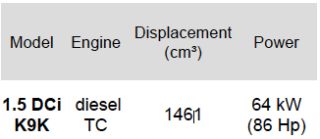
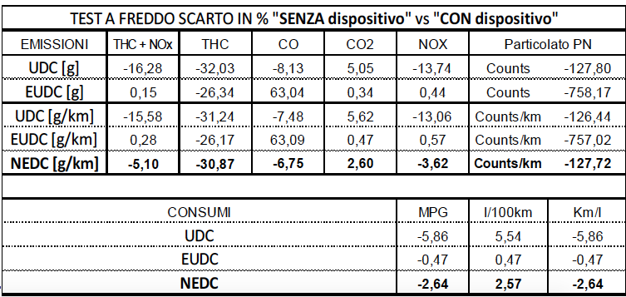
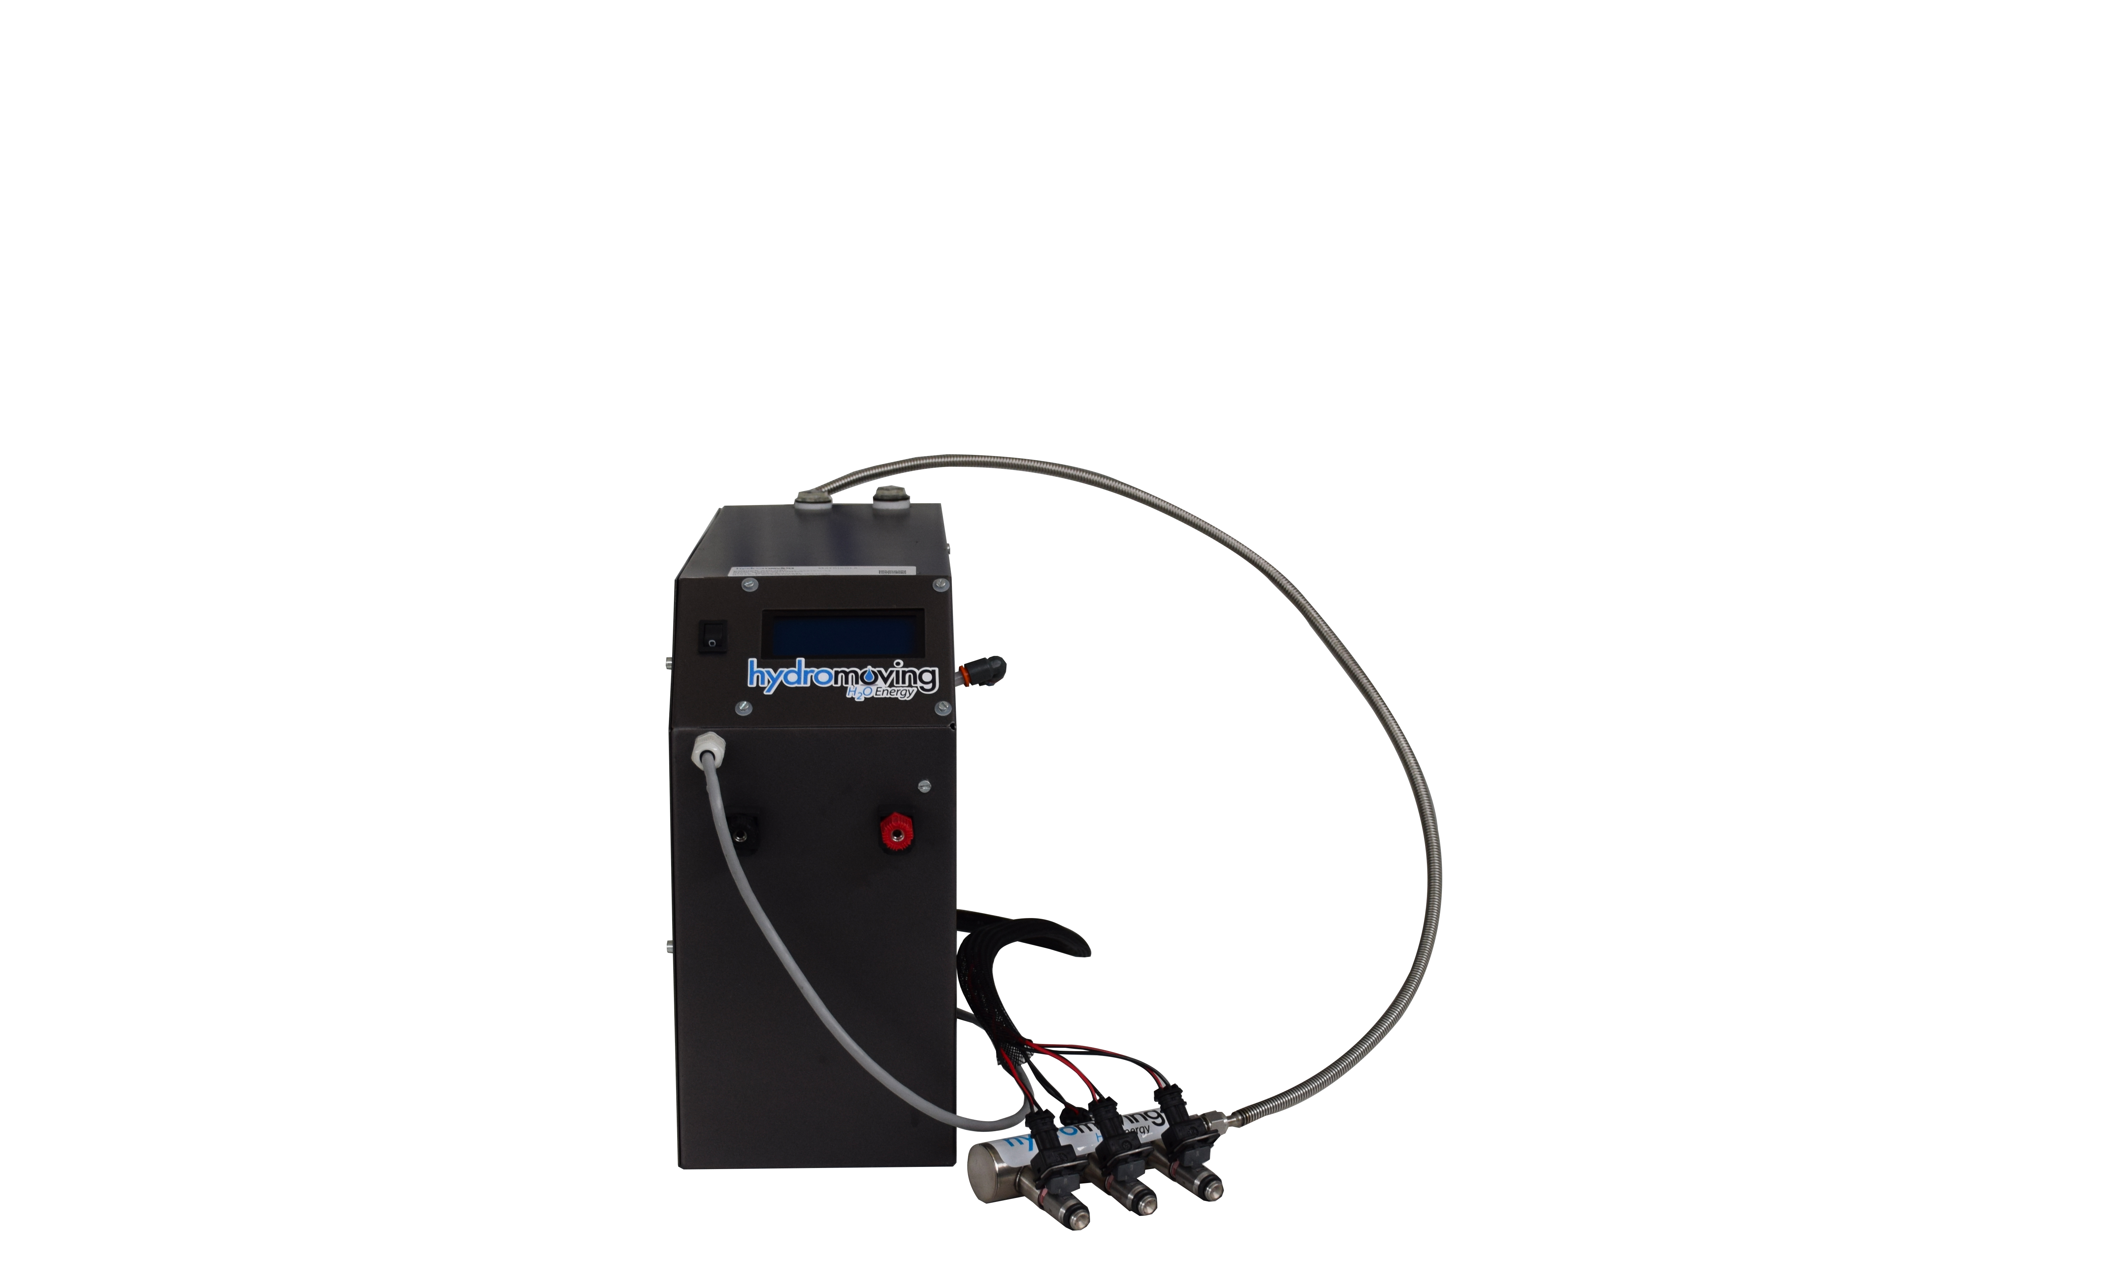
TESTED VEHICLE Results
Nissan NV200
cat. ‘N1’ – Class 3
Diesel fed
European NEDC Cycle
VEHICLE UNDER
CONDITIONING

Slide 37
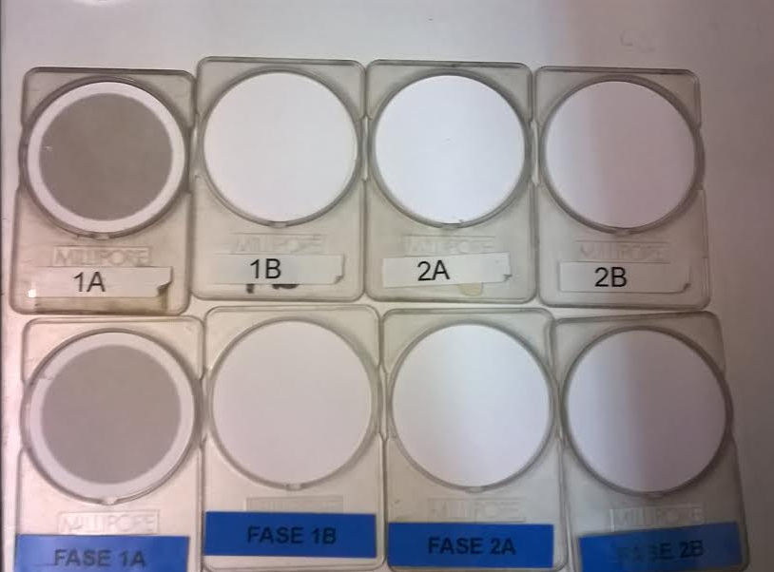
Particulate Reduction
Counts/km -127,72
Comparison of PM emissions with and without system, cold NEDC cycle
Details:
EUDC cold test without HM system> Photo 1A (Blue)
EUDC hot test without HM system> Photo 1A (White)
EUDC test cold with HM system (perfectly white filter)> Photo 1B (Blue)
EUDC test hot with HM system (perfectly white filter)> Photo 1B (White)
The excellence of the device is clearly visible.
Nissan NV200 gasoline Tdci
Without DPF/FAP

Slide 38
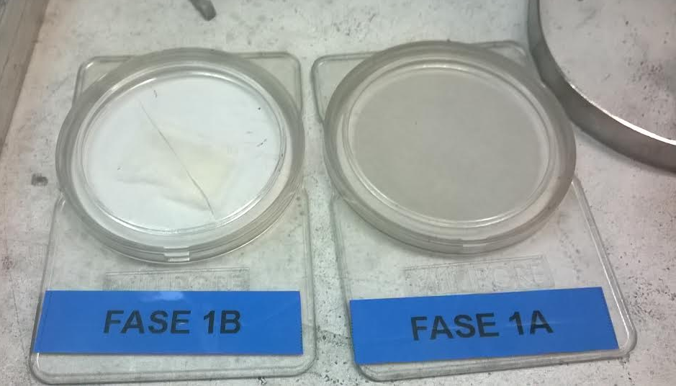
Particulate Reduction
Counts/km -190,07
Excellent Test of the efficiency of the HM system.
Perfectly White with HM system in operation.
Perfectly Black without the HM system
The HM system makes the EURO 6 Standard obsolete
Comparison of PM emissions with and without system, hot NEDC cycle
Nissan NV200 gasoline Tdci
Without DPF/FAP

Slide 39
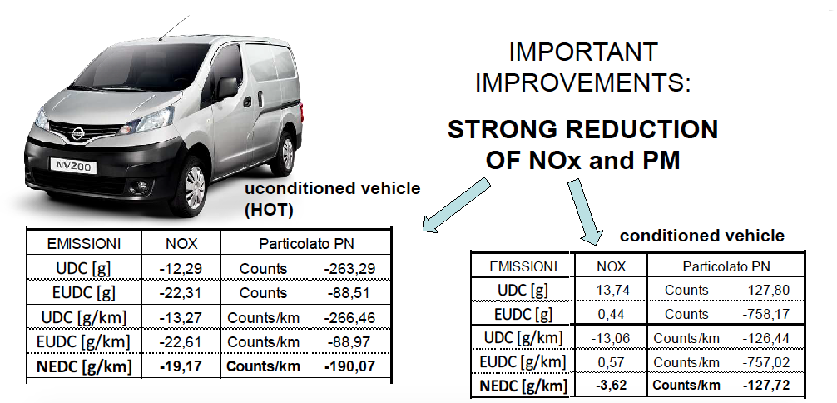
EMISSIONS
Nissan NV200

Slide 40
No_{x} Reduction
Nissan NV200
Comparison of NOx emissions with and without system, cold NEDC cycle

Slide 41
No_{x} Reduction
Nissan NV200
Comparison of NOx emissions with and without system, hot NEDC cycle

Slide 42
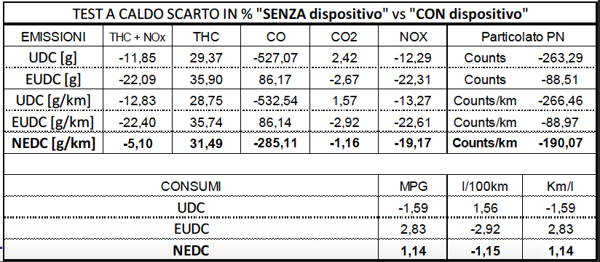
TESTED VEHICLE Results
Nissan NV200
cat. ‘N1’ – Class 3
Euro 5 Standards
without particulate filter
Diesel fed
European NEDC
Cycle
‘HOT TEST’
VEHICLE NOT
CONDITIONED

Slide 43
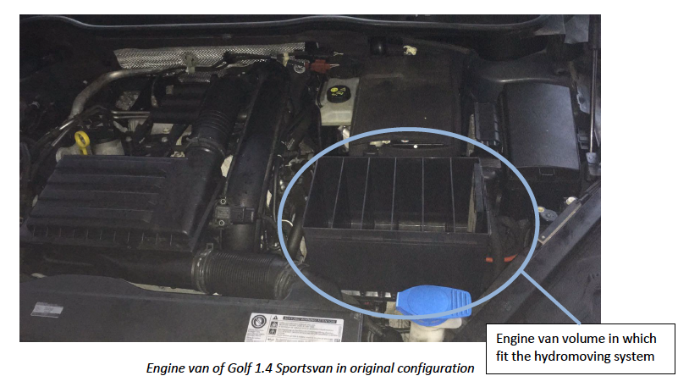
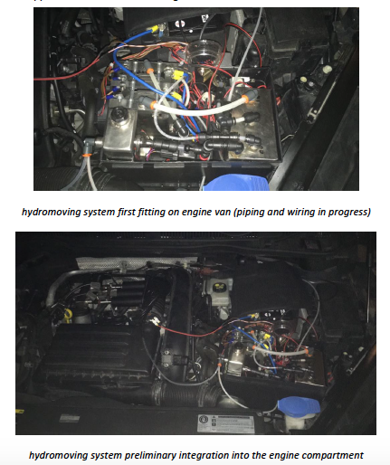
VW Golf 1.400 cc petrol fitting
The new systems can also be installed inside the engine compartment

Slide 44
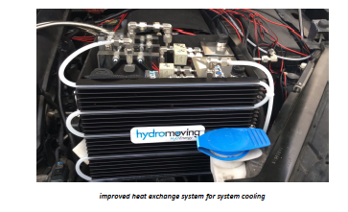
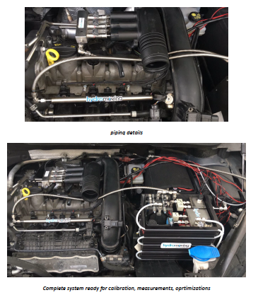
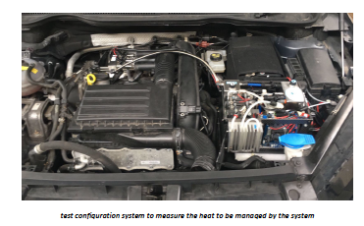
VolksWagen Golf 1.4 fitting

Slide 45
THANKS FOR SHARING
I am proud to inform you that on February 16th 2018 and March 16th 2018 we have graduated two engineers from the University of Bologna (Energy Engineering), who presented the Degree Thesis on the benefits of the Hydromoving System.
The Hydromoving company , has as its objective the granting of the license to use the HM Technology worldwide, and it’s therefore available at any Emission Test on engines of displacement from 500 cc up to 6000 cc in laboratories Emissions accredited with the Ministries of Transport of the country in which the test is to be performed.
The HM system compact can be installed in less than half an hour.
We hope that the documentation may be interesting for you.
For any info or proposal on the HM device.
Tks
Lorenzo Errico
Chairman & CEO Hydromoving srl - Italy
contacts for the info.
Mobile - + 39-331-2404681 (WA available)
Mail info@hydromoving.com
lorenzo.errico@gmail.com

